Slide 1
Mutual Fund Analytics Platform Bluestock Fintech – Data Analyst Internship Project Presented by: Nuha Pathan Tools Used: Python | SQLite | SQL | Power BI

Slide 2
Project Overview
Objective:
Analyze Indian Mutual Fund data
Build an ETL pipeline
Create a SQLite data warehouse
Perform SQL & Python analytics
Build an interactive Power BI dashboard

Slide 3
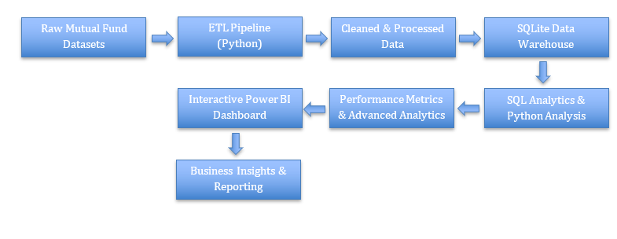
Workflow

Slide 4







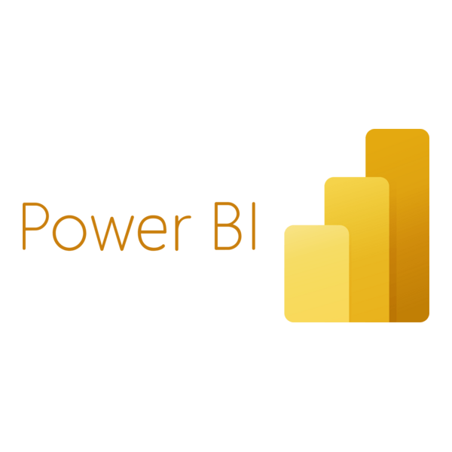
Technologies
Programming & Tools:
Libraries:
Visualization:

Slide 5
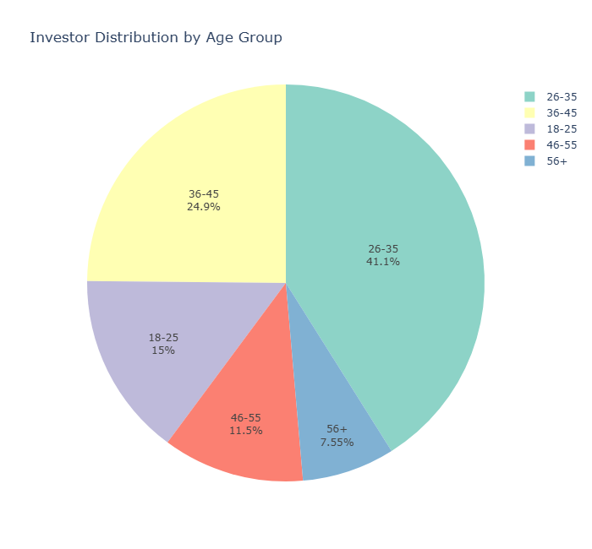
Exploratory Analysis
Age Group Distribution
The investor base is concentrated in the middle-age segments, indicating that individuals in their primary earning years contribute the largest share of mutual fund investments. Younger and senior investor groups represent comparatively smaller proportions.

Slide 6
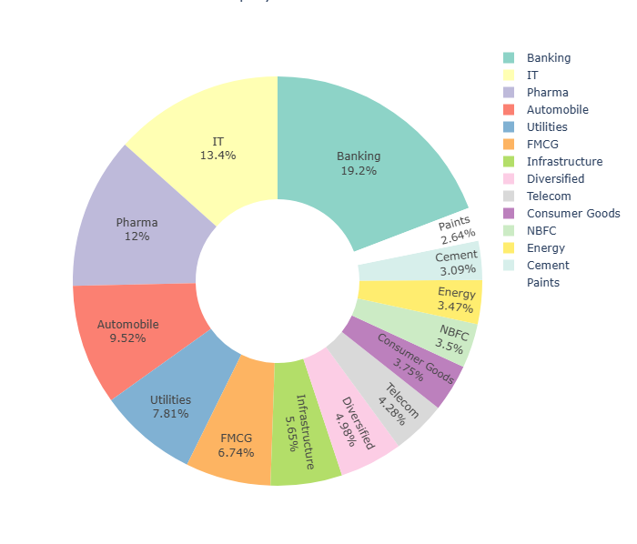
Exploratory Analysis
Sector Allocation
The donut chart illustrates the aggregate allocation of mutual fund portfolios across different sectors. Financial services, technology, and other major sectors account for a significant share of the overall portfolio weight, highlighting the sectors that receive the highest investment exposure across equity mutual funds.

Slide 7
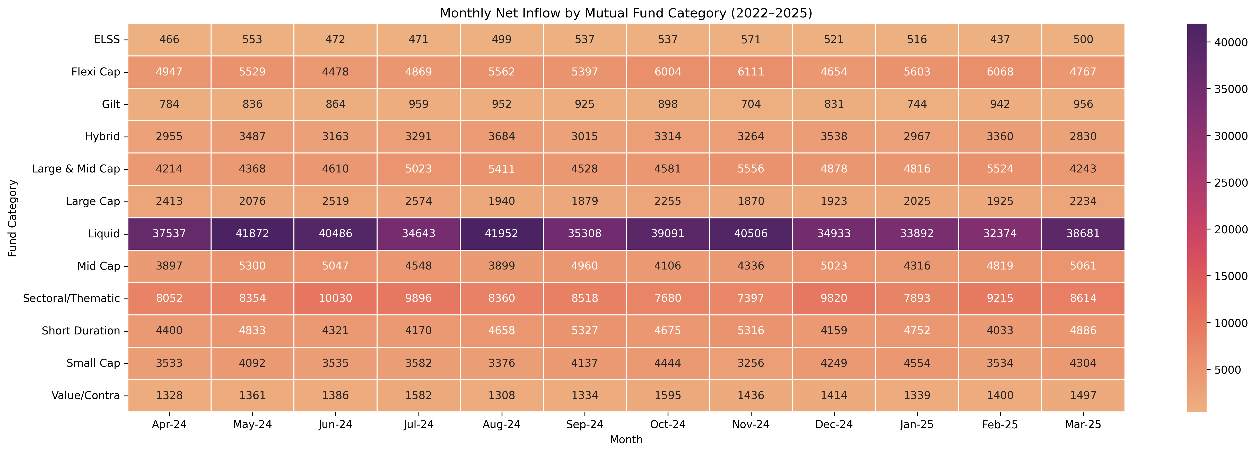
Exploratory Analysis
Category Inflow Heatmap
The heatmap reveals clear variations in monthly net inflows across different mutual fund categories. Equity-oriented categories consistently attracted higher inflows than other categories, while some categories experienced lower or fluctuating investments during certain months. The color intensity helps identify periods of strong investor preference and changing market sentiment between 2022 and 2025.

Slide 8
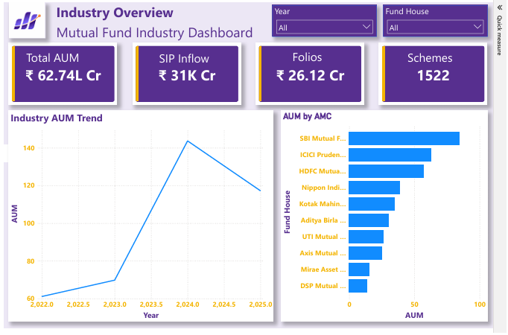
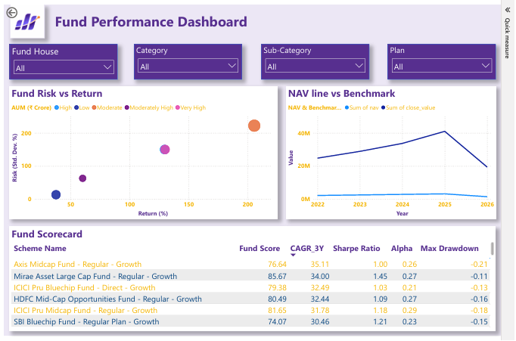
Power BI Dashboard
Industry Overview Dashboard
Fund Performance Dashboard

Slide 9
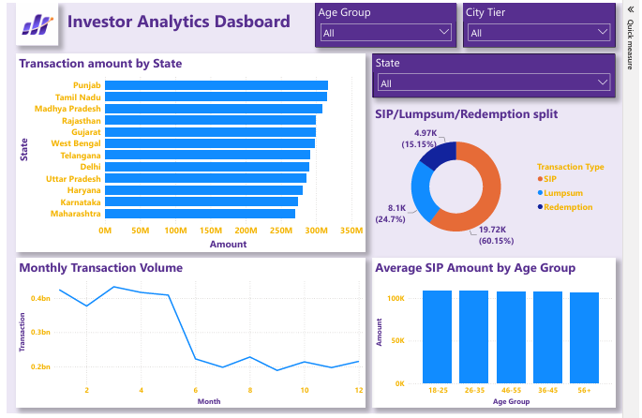
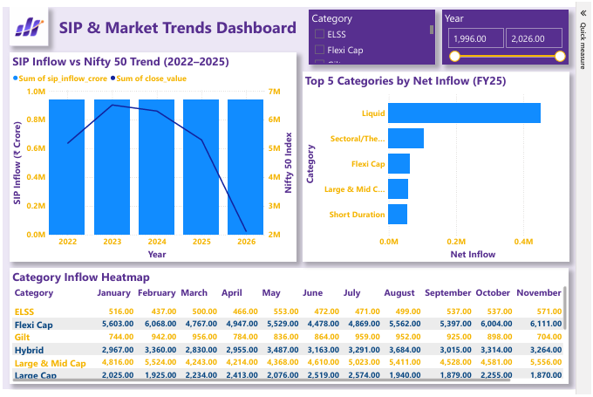
Power BI Dashboard
Industry Overview Dashboard
SIP Market Trends Dashboard

Slide 10
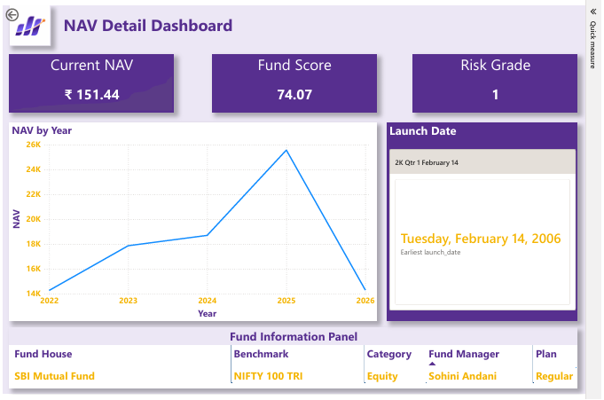
Power BI Dashboard
NAV Detail Dashboard

Slide 11
Key Analytics Performed
Risk Metrics | Performance Metrics
CAGR | Alpha
Standard Deviation | Beta
Sharpe Ratio | Tracking Error
Sortino Ratio | Fund Scorecard
Maximum Drawdown | Benchmark Comparison

Slide 12
Conclusion
Achievements:
Built reusable ETL Pipeline
Developed SQLite Data Warehouse
Performed Advanced Mutual Fund Analytics
Designed Interactive Dashboard
Generated actionable investment insights
Future Scope
Live NAV Updates
ML-based Fund Recommendation
Portfolio Optimization
Real-time Dashboard

Slide 13
Thank you

